Slide 1
Computer Vision
And some applications

Slide 2
Computer Vision In General
01
Modules
02
Hand Tracking
TABLE OF CONTENTS
03
Drag And Drop
04
Descripe the modules we used in our project
An application of Computer Vision
Another Application of Computer Vision

Slide 3
01 Computer Vision In General
Computer Science has a lots of application , one of its applications is AI ( Artificial Intelligence ) , one of its applications is Computer Vision .
Basically, Computer Vision is a field in AI that trains computers to analyze, interpret and understand the visual world using digital images and videos , then react to what they see.
In this presentation we will introduce you to Computer Vision Module ( CV ) and some of its methods , also some of its applications like ( Hand tracking , Drag and drop website) .

Slide 4
02
Modules
Descripe the modules we used in our project

Slide 5
Open_CV(cv2)
OpenCV is a great tool for image processing and performing computer vision tasks. It is an open-source library that can be used to perform tasks like face detection, objection tracking, landmark detection
Modules
Describe the modules we used in our project
MediaPipe
os
cvzone
A library through which you can make tracking by making a mesh on the required thing
method in python is used to get the list of all files and directories in the specified directory. If we don't specify any directory
This is a computer vision package that makes its easy to run Image processing and AI functions.

Slide 6
03
Hand traking
The principle of hand traking

Slide 7
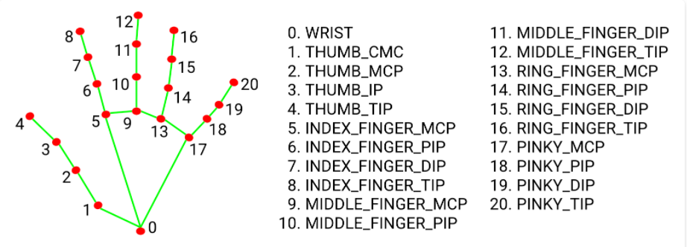
Hand tracking works on the principle that it distributes points on the joints of the hand and some points to be moved
In hand tracing, example libraries are used: CV2 and MediaPipe

Slide 8
04
Drag And Drop
The principle of virtual drag and drop

Slide 9
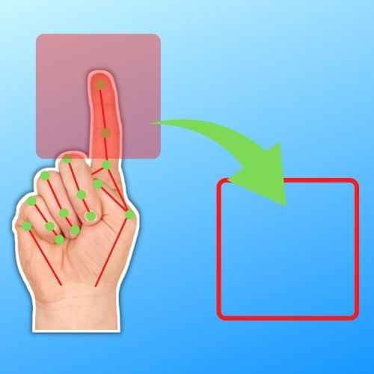
virtual drag and drop system using opencv and python.

